Slide 1
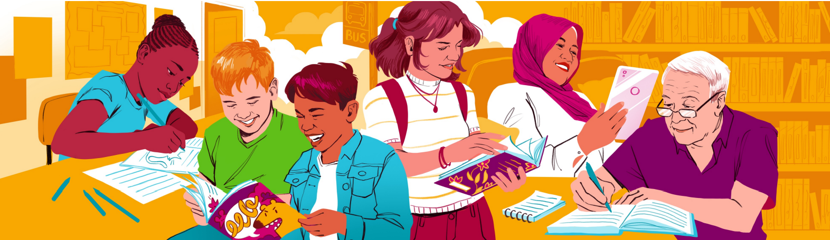


Representation in Fiction Books
Professor Sarah McGeown
Literacy Lab
University of Edinburgh
Dr Charlotte Webber
Strathclyde Institute of Education
University of Strathclyde

Slide 2

Representation in fiction reading
Representation of racially minoritised characters in books [1]
Representation of authors of colour [2]
Representation of LGBTQ characters [3]
[1] CLPE (2025) CLPE Reflecting Realities - Survey of Ethnic Representation within UK Children’s Literature. CLPE Reflecting Realities Report 2025.pdf
[2] Penguin Random House & The Runnymead Trust (2020) Lit in Colour: Supporting Inclusive Reading in Schools. Lit in Colour - Penguin Books UK | Official Site
[3] Keyser & Whitford (2025). Plot, Characters, and Representation: Patterns and Gaps in Award-Winning LGBTQ Children’s Books. https://doi.org/10.1080/19388071.2024.2340032

Slide 3
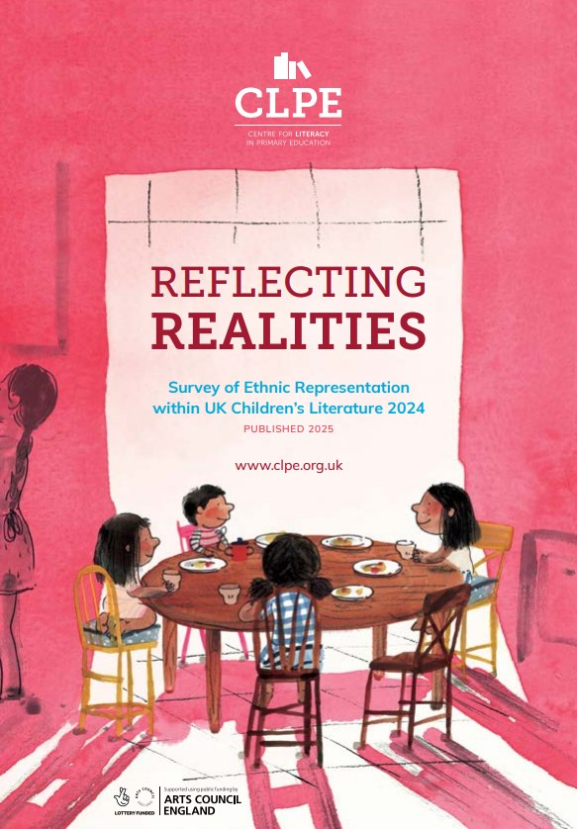
Representation of racially minoritized characters in books
CLPE Reflecting Realities Report 2025.pdf

Slide 4
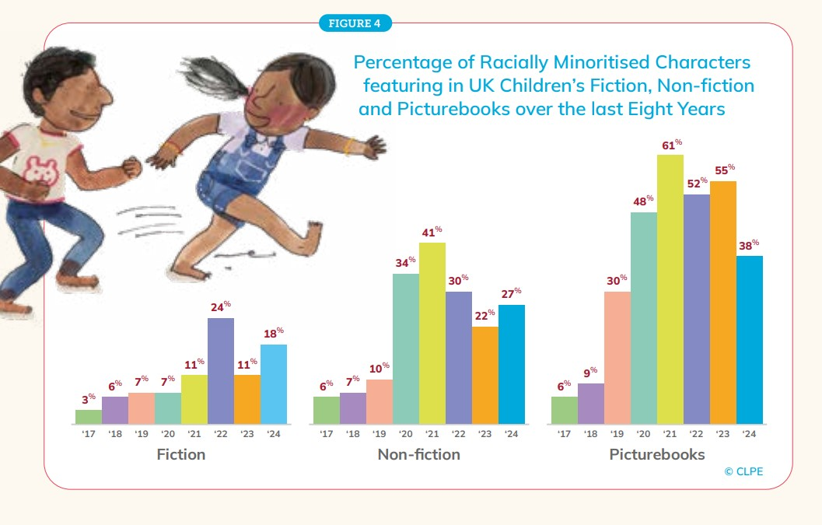
Representation of racially minoritized characters in books
CLPE Reflecting Realities Report 2025.pdf

Slide 5
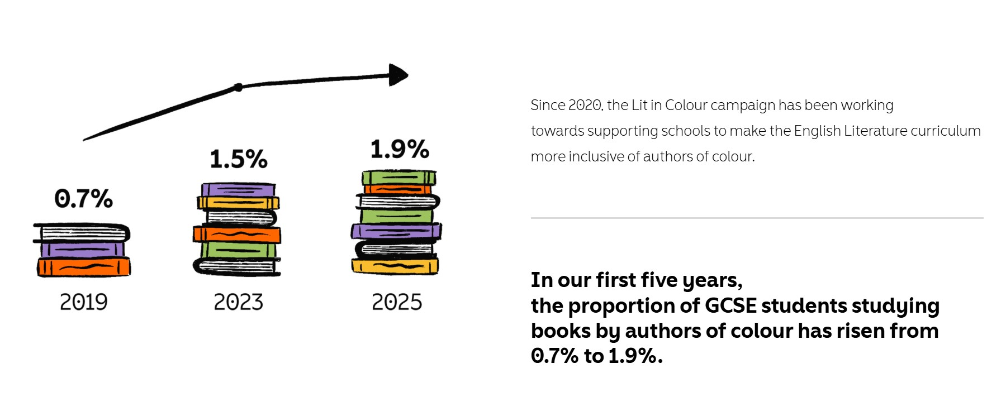
Representation of authors of colour in GCSE
Lit in Colour - Penguin Books UK | Official Site

Slide 6

Representation of authors of colour in GCSE
Lit in Colour - Penguin Books UK | Official Site

Slide 7
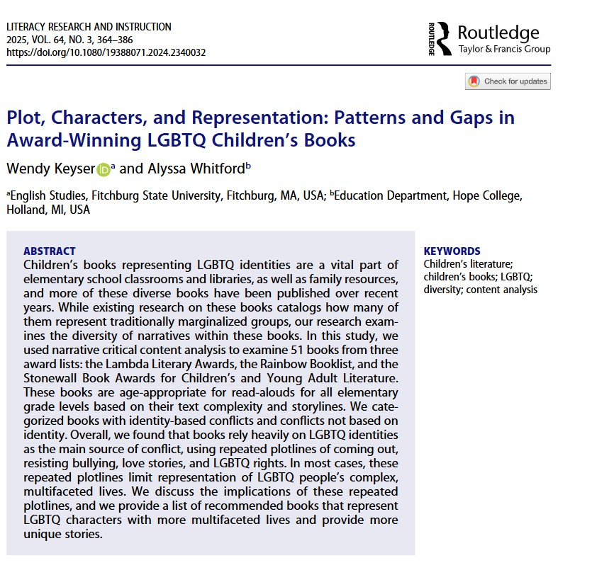
Representation of LGBTQ characters in books
Rather than focusing on number/proportion, examines diversity of narratives within books featuring LGBTQ characters.
Repeated plotlines of coming out, resisting bullying, love stories and LGBTQ rights.
Repeated plotlines limit representation of LGBTQ people’s complex multifaceted lives.
https://doi.org/10.1080/19388071.2024.2340032

Slide 8
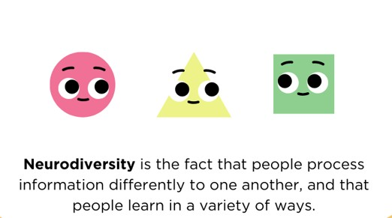
Neurodiversity and fiction reading
Taken from: Crompton, C.J., Fotheringham F., Webber, C., Cebula, K., Foley, S. & Fletcher-Watson, S., (2024) The NEurodivergent peer Support Toolkit (NEST). University of Edinburgh. https://salvesen-research.ed.ac.uk/download-nest

Slide 9
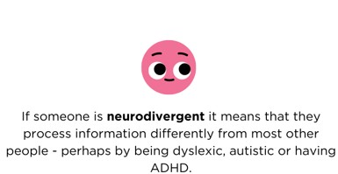
Neurodiversity and fiction reading
Taken from: Crompton, C.J., Fotheringham F., Webber, C., Cebula, K., Foley, S. & Fletcher-Watson, S., (2024) The NEurodivergent peer Support Toolkit (NEST). University of Edinburgh. https://salvesen-research.ed.ac.uk/download-nest

Slide 10
Neurodiversity & fiction reading project
Explored neurodivergent young people's experiences with representation in fiction books.
Database
Explored the scale and scope of representation of neurodivergent characters in fictional texts for teenage readers.
Created a database of these texts for future use.
Collaborative project including University-based researchers, literacy organisations (BookTrust, National Literacy Trust, Scottish Book Trust), children’s publisher (Barrington Stoke) and YA author (Victoria Williamson) and two teachers. Also involved neurodivergent young people in the design and piloting of interview schedule.

Slide 11
Neurodiversity & fiction reading project
Explored neurodivergent young people's experiences with representation in fiction books.
Database
Explored the scale and scope of representation of neurodivergent characters in fictional texts for teenage readers.
Created a database of these texts for future use.
Interviews
Interviews with 16 neurodivergent young people, (14–16-years-old) from 2 Scottish secondary schools.
Focused on benefits and potential harms associated with neurodivergent representation in fiction, and perceptions on ‘good’ representation.
Collaborative project including University-based researchers, literacy organisations (BookTrust, National Literacy Trust, Scottish Book Trust), children’s publisher (Barrington Stoke) and YA author (Victoria Williamson) and two teachers. Also involved neurodivergent young people in the design and piloting of interview schedule.

Slide 12
Database
*This was not a systematic search meaning some texts may be missing
Outcomes
239 books.
15 different neurodivergent identities.
Autism (127) most frequent, followed by OCD (28), Dyslexia (22), ADHD (13), and Tourette’s and Tic Disorders (13).
Slightly more male characters represented (119) than female (100); 1 non-binary character.
Most characters had one diagnosis.
Neurodivergent characters in YA fiction: who is being represented?
www.scottishbooktrust.com/articles/neurodivergent-characters-in-ya-fiction

Slide 13
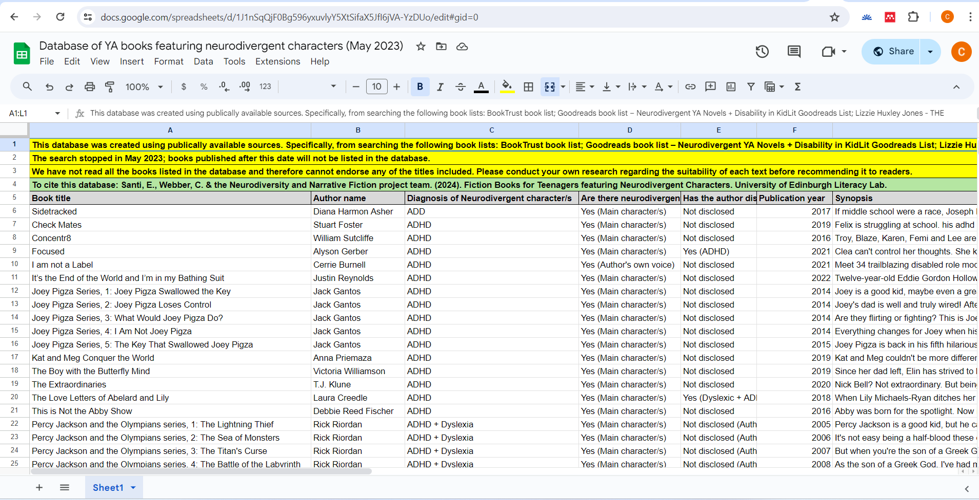
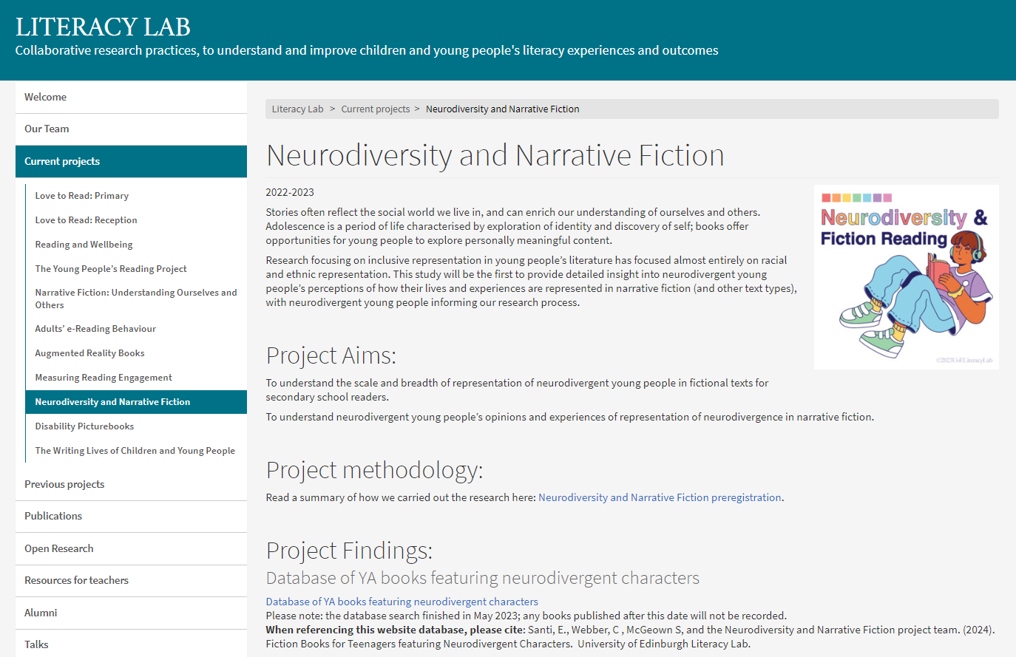
Database
Access via our website: https://blogs.ed.ac.uk/literacylab/current-projects/neurodiversity-and-narrative-fiction/

Slide 14
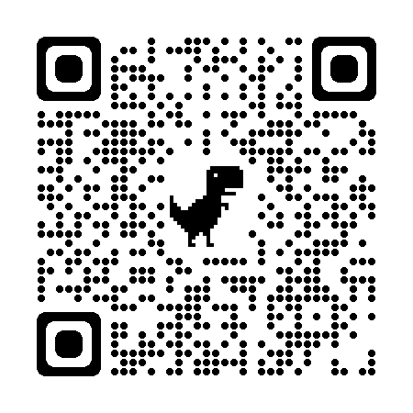
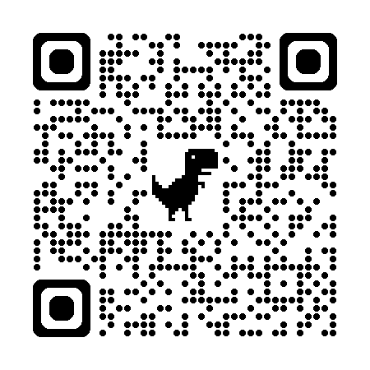
Interviews
Neurodivergent young people’s perceptions of representation in YA fiction
N=16 neurodivergent young people (14–16-years-old) from 2 Scottish secondary schools
Webber, C., Santi, E., Crompton, C. J., Fletcher-Watson, S., & McGeown, S. (2024). Representation in fiction books: Neurodivergent young people's perceptions of the benefits and potential harms. Neurodiversity, 2, https://doi.org/10.1177/27546330241237881
Webber, C., Santi, E., Cebula, K., Crompton, C. J., Fletcher-Watson, S., & McGeown, S. (2024). Representation of neurodivergence in fiction books: Exploring neurodivergent young peoples' perspectives. Literacy. https://doi.org/10.1111/lit.12369

Slide 15
What are the benefits of neurodivergent representation?
1. Helps neurodivergent young people to understand and accept their neurodivergent identity
“if I was to read a book that, like, accurately represented someone with a similar neurodivergence to me… I’d sort of understand and be able to, like, connect [my] experiences to neurodivergency.”
“[The book] was about accepting that this is a thing that you have, and that it has strong points as well. That it is not all bad.”

Slide 16
What are the benefits of neurodivergent representation?
2. Helps neurodivergent young people understand other neurodivergent identities
“I know what neurodivergence I have, but I don’t know about what it's like to have other neurodivergences, so I think I could benefit from that by learning about others that have similar things to me, but not the same as what I have.”

Slide 17
What are the benefits of neurodivergent representation?
3. Helps neurodivergent young people feel positive emotions (e.g., happiness, comfort, safety)
“I could like, figure out, like, a few things, like, that remind me of autism and stuff, and it's really cool to spot like stuff like that in characters … it made me feel, like, really comfortable and happy.”
“It could also be good for other people who may feel left out … and it can make them feel like they’re not alone, even though it is just a book.”

Slide 18
What are the benefits of neurodivergent representation?
4. Could help reduce stigma and increase peer understanding
“it's quite hard to explain what you struggle with when it's not something that you can physically see with the person, because if they don't-, if you've never experienced it, then it's probably harder to understand…So if they read the book, then they might understand.”
“It's easier when you see things as, like, a story than if you’re just meeting someone, because if you don’t understand prior then you’ll just think they’re weird …[they could understand] the way we think and the way we see the world and the way we feel. Seeing us as actual people.”

Slide 19
What are the benefits of neurodivergent representation?
4. Could help reduce stigma and increase peer understanding
…but where young people had friends who they felt already understood their needs and experiences, reading books about neurodivergent characters was not as necessary
“Because [your friends] already know you more as a person and they’re going to know ways how you will struggle and how you can cope with that, and the things you’re good at.”

Slide 20
What are the benefits of neurodivergent representation?
5. Reading about neurodivergent characters at a younger age could have helped them experience all these benefits sooner
“I think if I read more books with dyslexic characters, I think I would-, I think, I don't know. I think I would realize that maybe I'm not just really rubbish at spelling, maybe I do have a problem that can be supported.”
“When I was diagnosed, I was very scared of telling people…but I feel like maybe if I'd sort of read books at a younger age...think it probably would have helped me a lot more back then, sort of, telling people.”

Slide 21
What are the potential harms of neurodivergent representation?
1. Negative, inaccurate, or stereotypical representations of neurodivergence could increase stigma
“What the misrepresentation could also do is it can lead to stereotypes, it can lead to things being built, it can lead to these sort of, you know, misunderstandings or hatreds of the conditions.”
“I think a good way for representation is when…[it] doesn’t, like, sort of perpetuate, like, harmful stereotypes, because otherwise I’d just rather not be represented if it's, like, offensive.”

Slide 22
What are the potential harms of neurodivergent representation?
2. (Negative) changes in peers’ attitudes/behaviour
“The way [others] act around you, or maybe the way they perceive you would probably change if they’re seeing all these negative things about a condition and then, you know, it can just sort of change how they might behave towards you.”
“The only thing I wouldn’t like is, if it came off as a thing where people will start like being, around me all the time, like asking me how I am … it would need to be a positive thing that isn’t coming off as ‘I feel sorry for you’, you know?”

Slide 23
How do neurodivergent young people want to be represented in fiction?
Representation of neurodivergence should be complex, realistic, and positive
Representation of neurodivergence should be normalised
Representation of neurodivergence beyond books is important.
“Especially as a trans person, like, usually if you see autistic representation it's, you know, a cisgender white child and it just doesn't feel very true to life”
“Just don't make a big deal out of it. Making a big deal out of it sort of gets rid of the actual point that we want this to be casually embedded, we don't want a big deal made”.

Slide 24
Implications….
Support pupils to access to texts featuring a diverse range of neurodivergent characters (with different diagnoses and demographics) which capture a variety of neurodivergent experiences.
Involve neurodivergent pupils in recommending and selecting books (but be mindful that they might not want to).
Provide access to texts in different formats (e.g., graphic novels, audiobooks) and modes (e.g., reading aloud, linking to film/TV adaptations).
Encourage pupils to critically engage with representations of neurodivergence in texts.

Slide 25
New project…..
Neurodivergent reading realities: Identity and collective meaning-making through neurodivergent-led book groups
Empowering neurodivergent students to co-construct meaning and understanding about their (collective and individual) neurodivergent identity/identities through participation in neurodivergent-led book groups, exploring:
  (1) Whether/how reading books about neurodivergence can affirm, undermine, challenge and/or expand their neurodivergent (and intersecting) identities.
  (2) The methodological potential of neurodivergent-led book groups as a safe space for facilitating collective meaning-making regarding neurodivergent identity and culture.
Email: charlotte.webber@strath.ac.uk

Slide 26
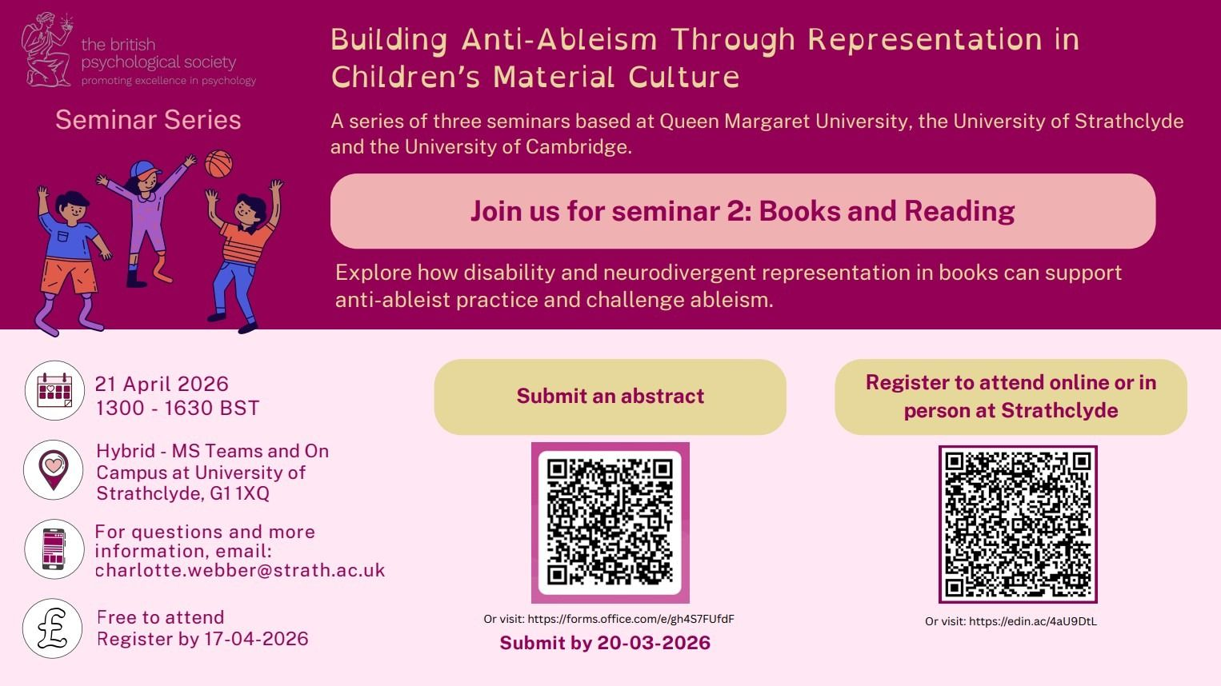

Slide 27
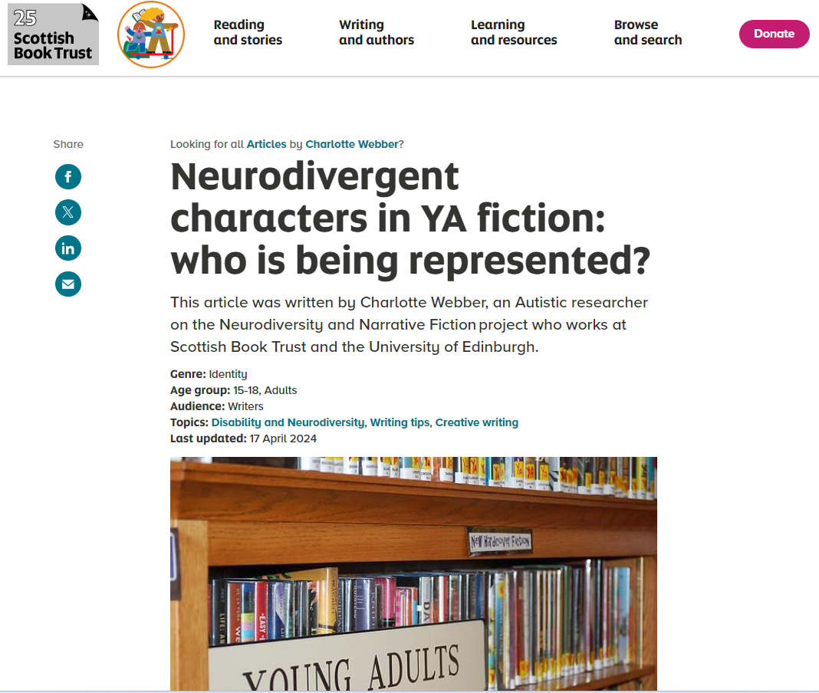
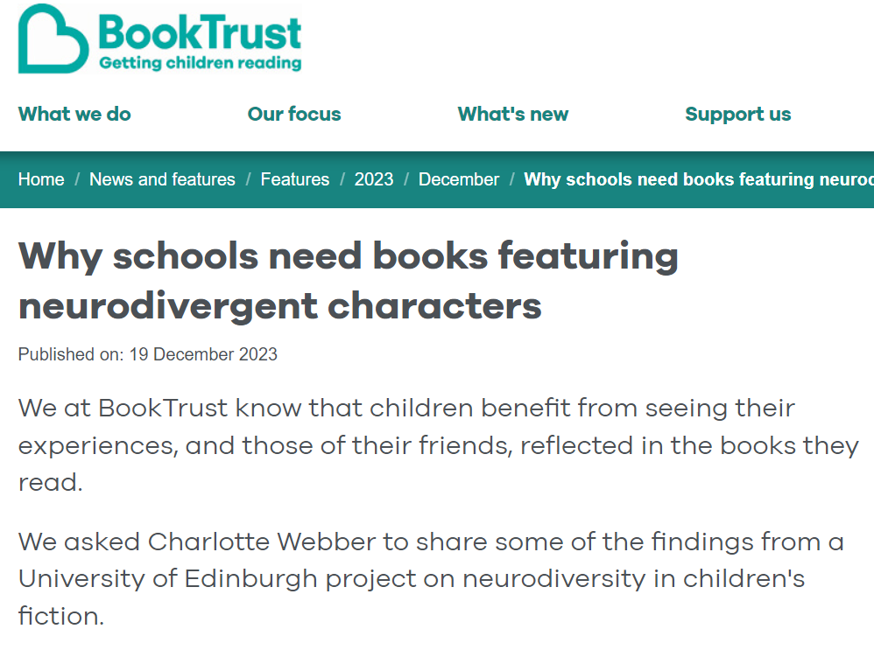
Quick reads…
Neurodivergent characters in YA fiction: who is being represented? (Scottish Book Trust)
Writing neurodivergent characters: advice from neurodivergent teens (Scottish Book Trust)
Why schools need books featuring neurodivergent characters (BookTrust)

Slide 28
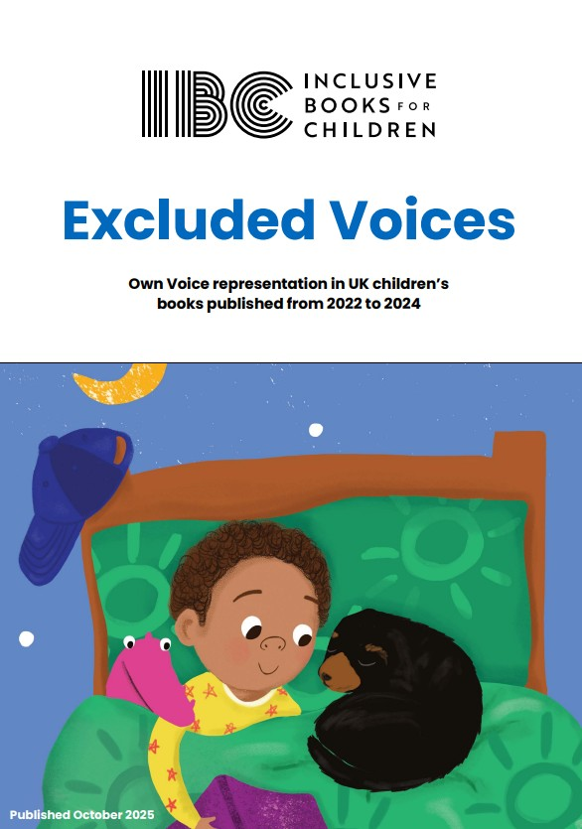
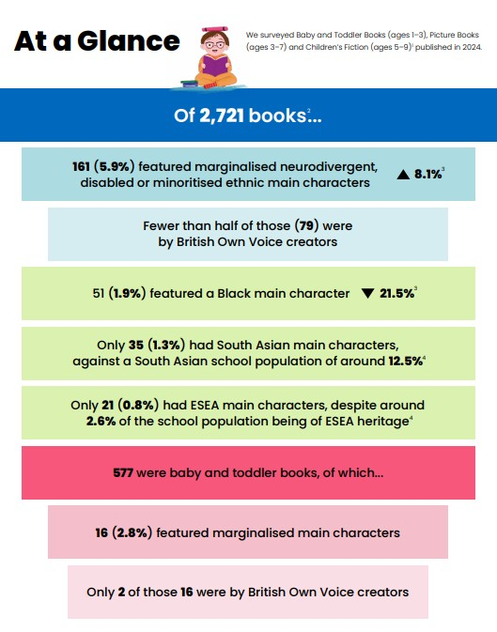
Representation: For younger readers….
https://www.inclusivebooksforchildren.org/excluded-voices-report

Slide 29
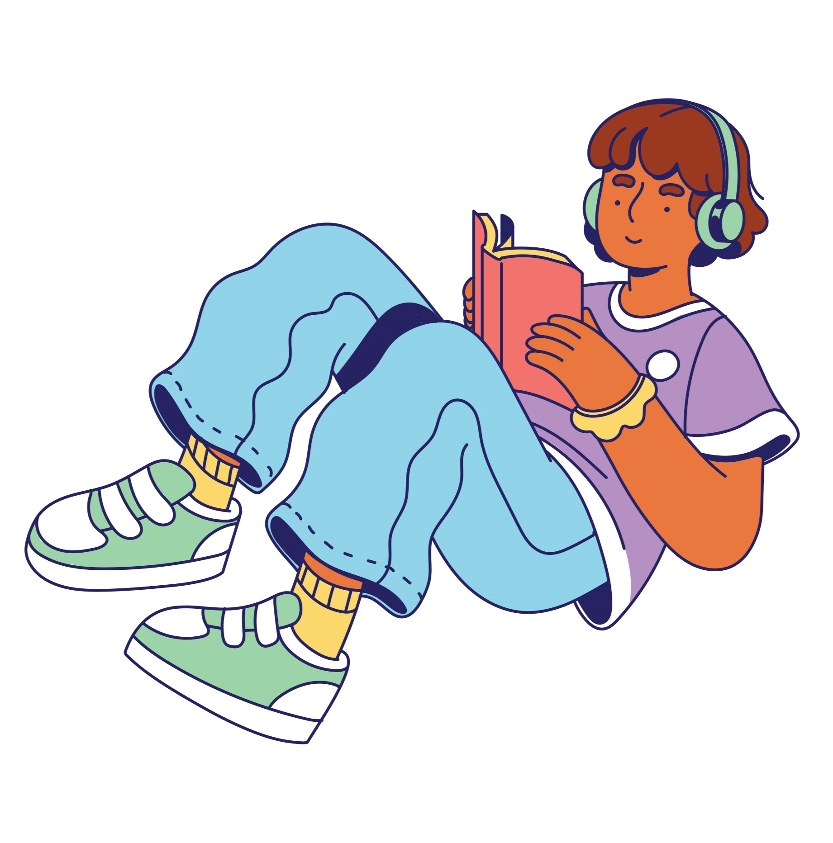
Many thanks to all the young people who participated and so generously shared their reading perspectives and experiences.
Research team:
Dr Charlotte Webber, Elena Santi, Prof Sarah McGeown, Dr Katie Cebula, Dr Catherine Crompton, Prof Sue Fletcher-Watson
Practice partners:
Dr Christina Clark, National Literacy Trust
Lucy Juckes, Barrington Stoke
Katie Juckes, Teacher
Eadaoin Lynch, Scottish Book Trust
Daniel Payne, BookTrust
Emily Weston, Teacher
Victoria Williamson, Author
Funding from University of Edinburgh Challenge Investment Fund.

Slide 30
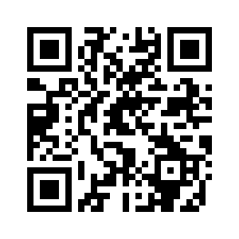

Reflection and discussion
What key messages did you take from this webinar, and how could you use these to support your practice?
What does your current book provision look like in terms of diversity, representation, and intersecting identities?
Thoughts on future research interests and priorities…
University of Edinburgh Literacy Lab: https://blogs.ed.ac.uk/literacylab/

