Slide 1


“Shut the door.”
…meaning builds from a contingent dialogue between author, text and readers.

Slide 2

‘She shall come in,’ answered the open door,
‘And not,” said the room, ‘go out anymore.’
Who are the characters?
The door, the room, and the ‘she’ they speak of
What could the mysterious situation be?
Think of at least two reasons why ‘she’ will not be able to ‘go out anymore’
Notes:
Trap her?
Protect her?
Welcome her back in?
Most plausible??

Slide 3

‘There’s someone at the door,’ said gold candlestick:
‘Let her in quick, let her in quick!’
‘There is a small hand groping at the handle.’
‘Why don’t you turn it?’ asked green candle.
Rhythm and phrasing
Mark-up codes
/ short pause
//long pause
⤴️ rising tone
⤵️ falling tone
😮 exclamation
_____ word emphasis/stress
⬇️ Slow down
⬆️ Speed up

Slide 4
Ellen | So let’s hear from this group, A, can you share your group’s idea – Why can she not go out anymore??
Pupil A | We think she was captured and now she’s escaped.
Ellen | What made you think that?
Pupil A | Well, like, the room, no sorry the candlestick really wants her to come in because it says ‘Let her in quick’ so maybe it’s saving her.
Ellen | Thankyou. The rest of the group - is there any other evidence that suggests she’s escaped?
Pupil A’s group | Erm.. (looking at poem...silence)
Ellen | Maybe we could all look at this. Is there anything else that suggests she’s been captured somewhere and is escaping back to the room. (gives time for all pupils to re-read) Yes – Pupil B
Pupil B | Well, she’s groping at the handle which could mean she’s a bit panicky and wants to get in.
Ellen | That’s helpful, thankyou. How about this group – did you have a different idea to A’s group?
How is Ellen supporting children to become readers through dialogue?

Slide 5
How is Ellen supporting children to become readers through dialogue?
Pupil C | Yeah, so we think she’s gone out without permission and the room wants to get her back in and trap her.
EG | Because...
Pupil C | Because...so...the ‘let her in quick’ does suggest that they want her back but then the ‘not go out any more’ is just a bit spooky. It’s a bit weird to never let her go out again.
EG | Interesting – so let’s test this out a bit more. How about the groping at the handle that pupil B mentioned? Yes – Pupil D can you pick this up...
Pupil D | So, that might be...so she might be nervous to come back in and her hands are sweaty and slippery.
EG | And she’d be nervous because...?
Pupil D | ...she knows the room is going to be cross with her
Pupil A | Oh that actually makes sense!
EG | Thanks. Pupil A – why does that make sense?

Slide 6

Learning Dialogues Chapter 8
The aim of the session is always to make meaning together rather than arrive at a predetermined answer. When children are encouraged and supported to explore and evaluate their own thinking, without overt judgement, they become more confident in expressing their ideas and are more willing to change them in the light of evidence.
Ellen Glynn
Overton Primary

Slide 7

Comprehension is a construction of meaning with the text not an extraction of meaning
What helps me to build my mental representation?
Prior knowledge and experience of texts ‘like this’ – relating part to whole – pattern seeking
Structure of the story
Vocabulary and syntax – language capability
The ability to make plausible inferences – verbal reasoning
The author’s complex mental representation
The reader’s existing mental representation
Notes:
Can seem a lonely, silent struggle
Good and motivated readers hear the voice of the texts and their responses to it internally

Slide 8

Structured talk IS reading comprehension
Beck & McKeown (2015)
Making the internal process of comprehension external through a see-saw of dialogic talk and application tasks
The author’s complex mental representation
Reading is a social and relational act – we explore and construct our relation to the text, the world and to each other through the text
The reader’s existing mental representation

Slide 9
Green Candles
‘There’s someone at the door,’ said gold candlestick:
‘Let her in quick, let her in quick!’
‘There is a small hand groping at the handle.
‘Why don’t you turn it?’ asked green candle.
‘Don’t go, don’t go,’ said the Hepplewhite chair,
‘Lest you find a strange lady there.’
‘Yes, stay where you are,’ whispered the white wall:
‘There is nobody there at all.’
‘I know her little foot,’ grey carpet said:
‘Who but I should know her light tread?’
‘She shall come in,’ answered the open door,
‘And not,’ said the room, ‘go out any more.’
Humbert Wolfe, 1925
Concept question:
What makes the poem so dramatic?
This link takes you to a tutorial of the unit on the Crown House Youtube site

Slide 10
Annabel Davis Yr 4 Overton Primary School
Shut the Door
‘’Don’t open it!’’ said the oil lamp.
‘’We don’t know who is on the ramp.’’
‘’Lock it quick, lock it quick!’’ said the stained wall.
“I don’t want her here now, not at all.”
“Let her in, let her in!” exclaimed the old books.
“Unlock the window, open all nooks.”
“I see her little feet.” Said dusty floor.
“Yes, yes open the door!”
“Lock the door!” said the grand fireplace.
“Let’s not meet her face to face.”
“I agree!” announced broken comb.
“Don’t let her in send her home!”
Shut the Door - Stubbington version
“The coach is here!” said the large door.
“I hear the roar; I hear the roar!”
“I’m so excited they’re staying the night.”
“Why are they late?” asked the bright light.
“Oh no, oh no!” said the blue cubby square.
“I don’t think they’ll play very fair.”
“I agree.” whispered folded sheet,
“All children have stinky feet!”
“I know it’s the children.” fuzzy carpet said.
“Who else knows their light tread?”
“It will be fun!” answered little lost teddy.
“But also,” said the dorm.” We will be ready.”

Slide 11
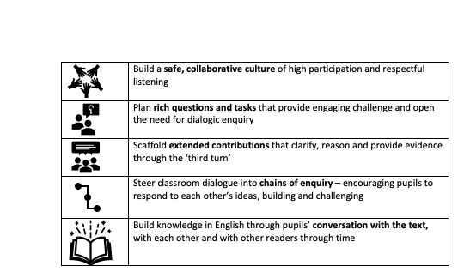
Chapter 8
Learning Dialogues

Slide 12
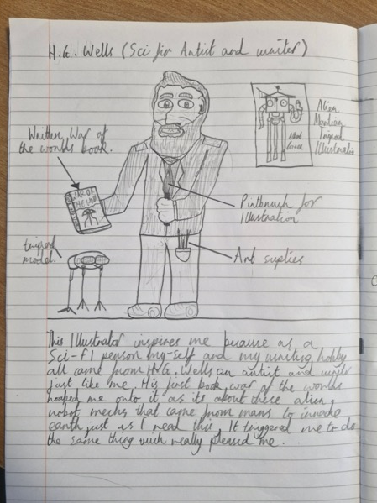
Georgie Allen
Penn Wood Primary Slough
Robert Year 9
Loved only Wimbledon FC
A Midsummer Night’s Dream
Nicholas Year 8
Eddie Stobart Lorry Spotting
The Rime of the Ancient Mariner

