Slide 1

Growing GCSE English Language re-sit students in FE
Matthew Ruddle
Abingdon & Witney College

Slide 2

How can we motivate and engage our students?
How can we develop their independent thinking?
Young Writers 100-word stories
The Thinking Environment
Co-curate a Collaborative Curriculum

Slide 3
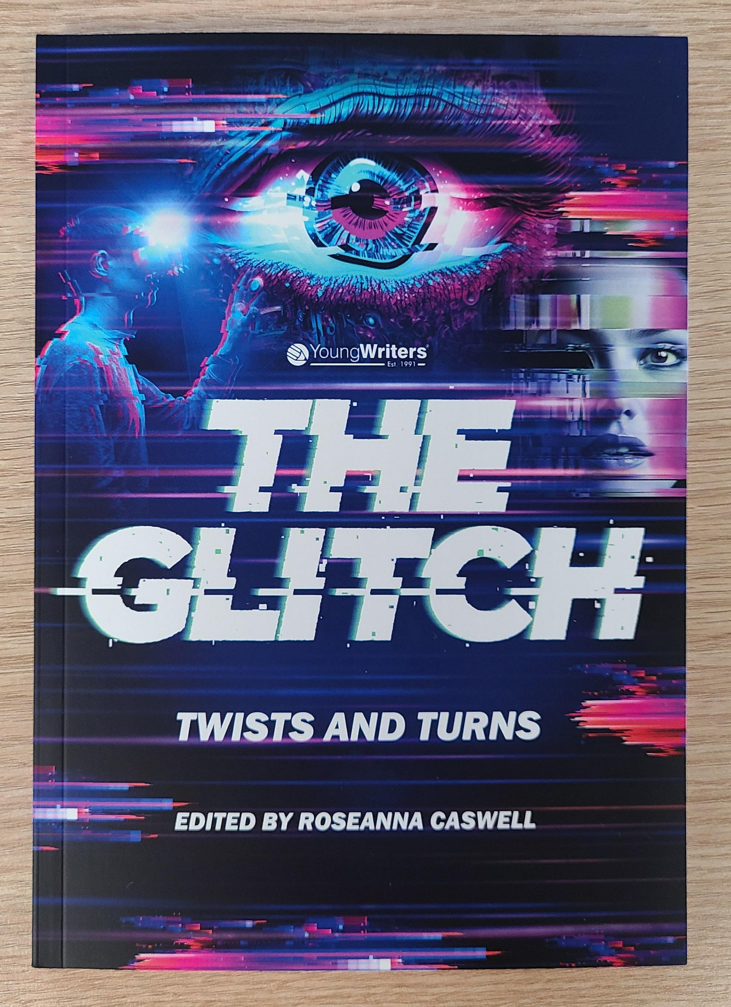
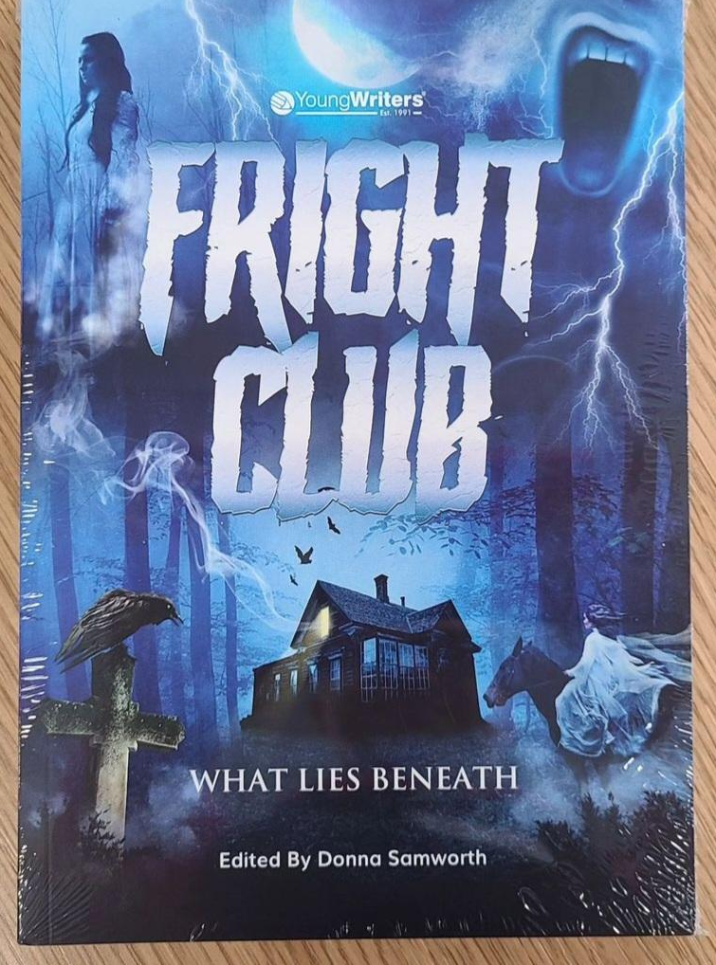
Young Writers www.youngwriters.co.uk
Free creative writing resources and competitions
100-word stories to boost creative writing skills
Publish students’ creative writing

Slide 4
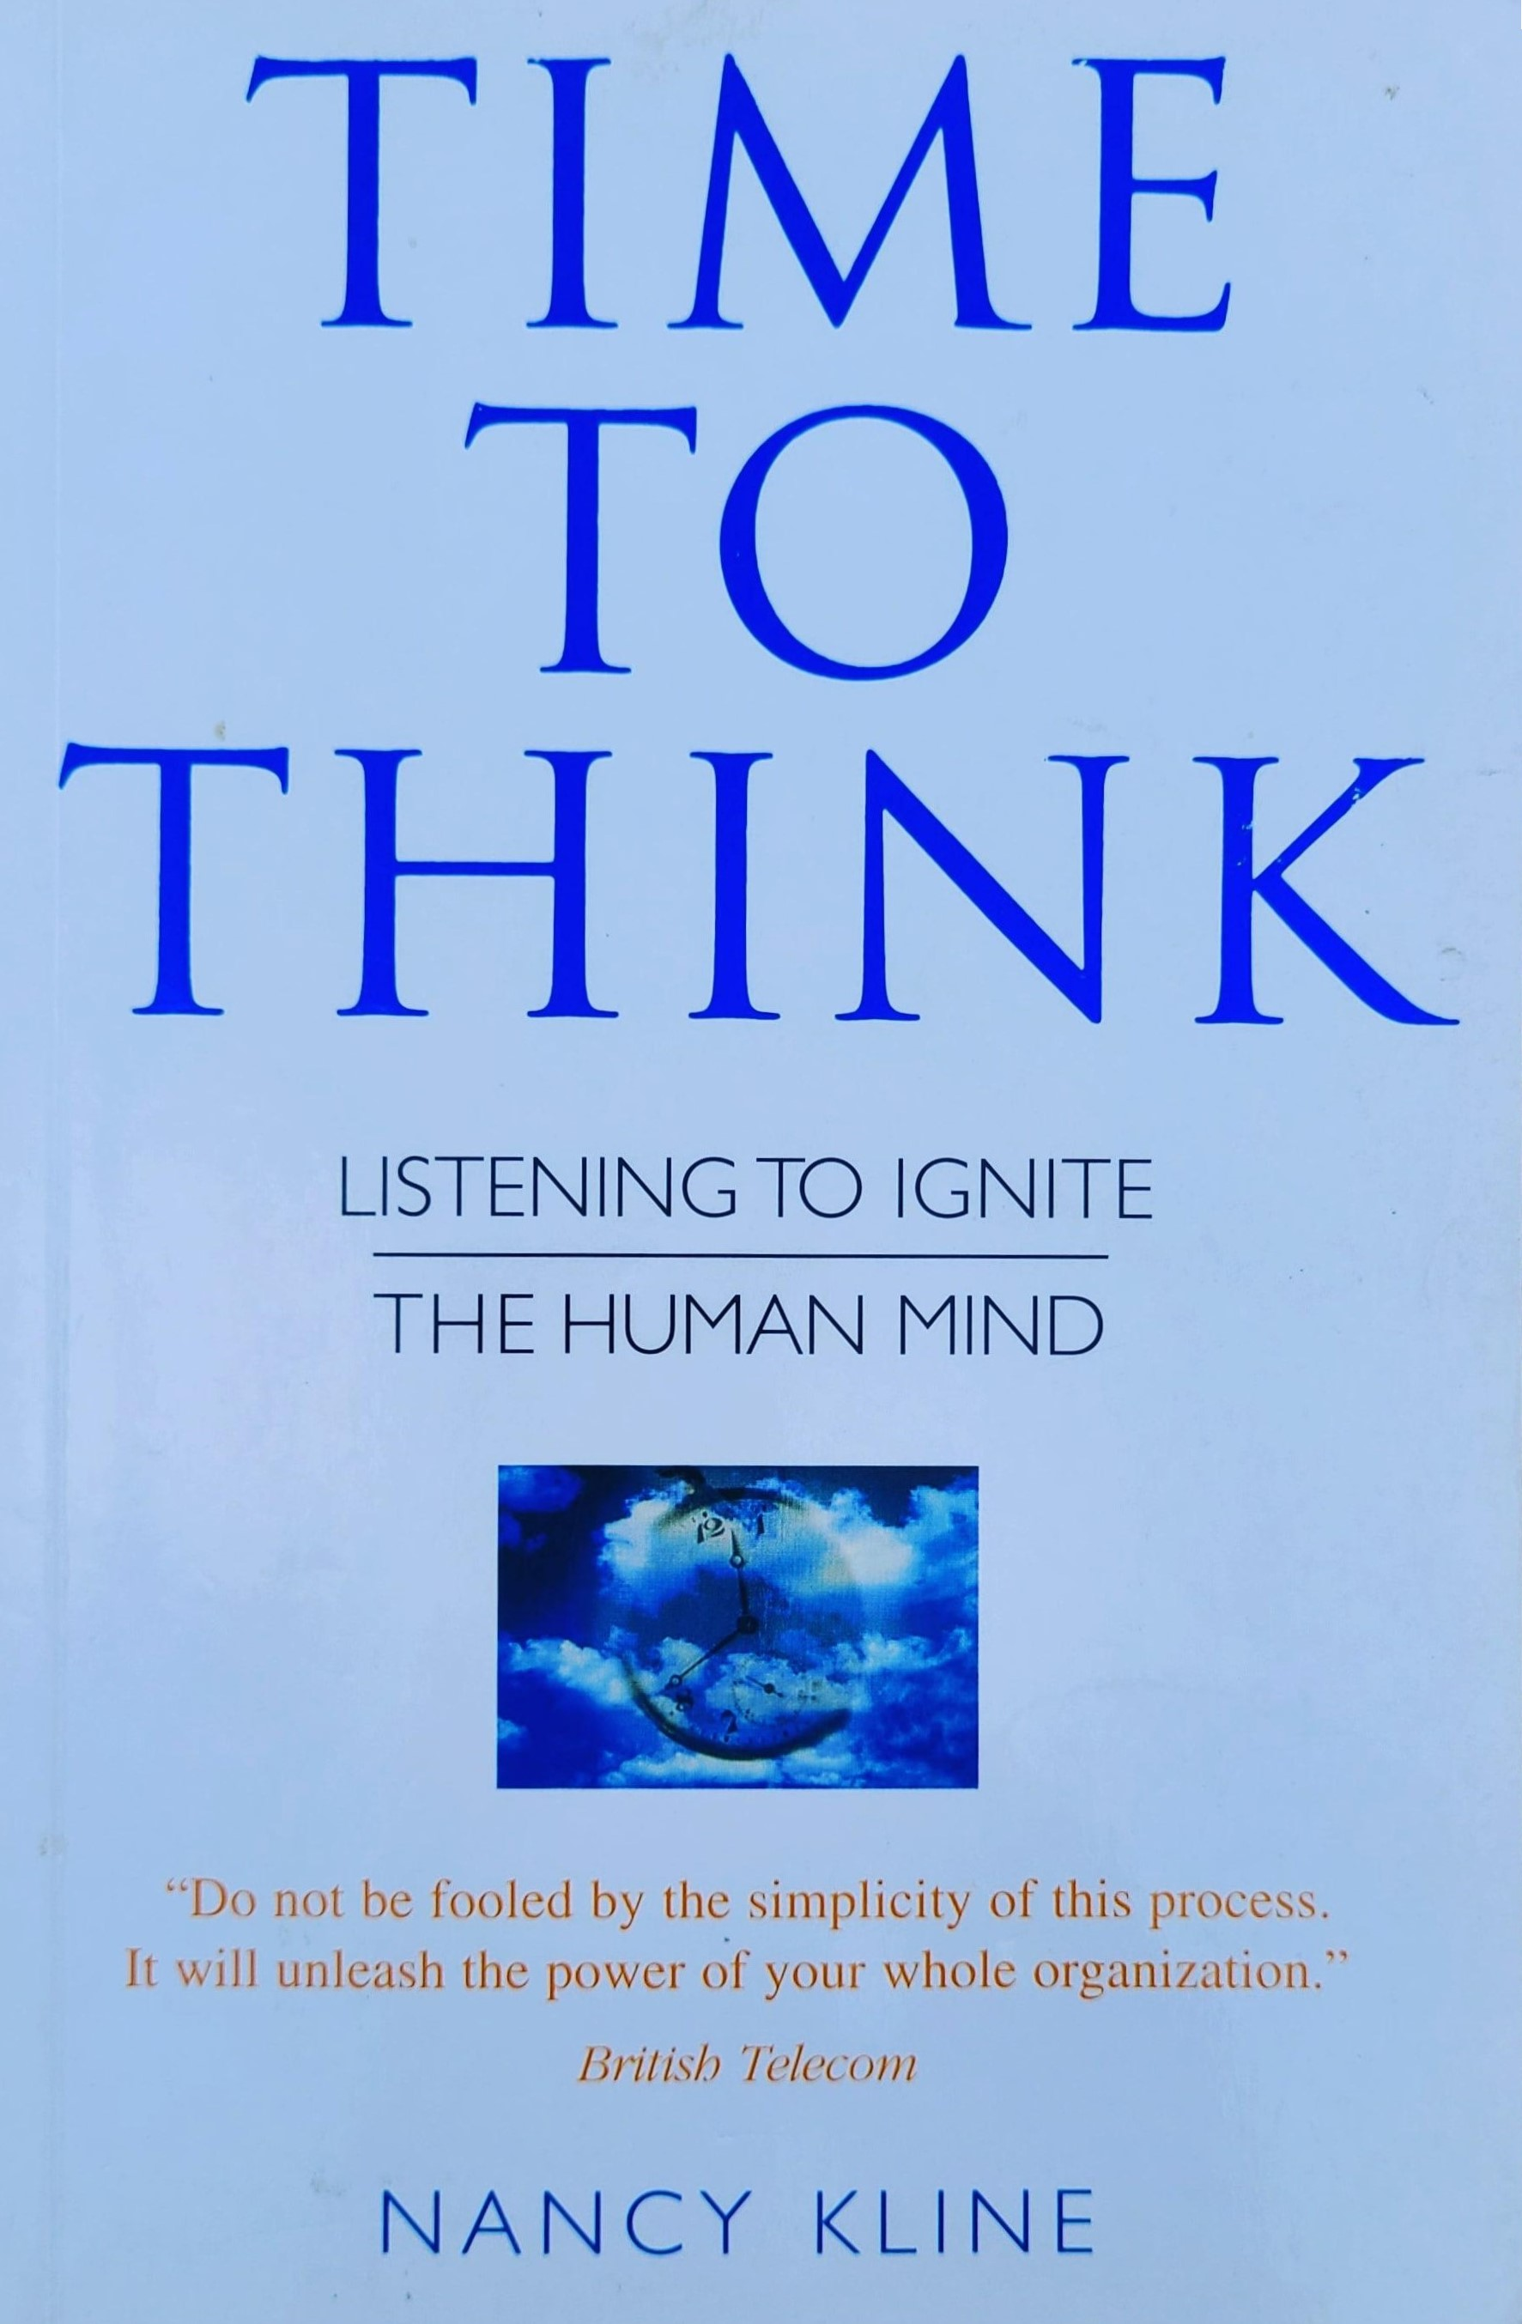
The Thinking Environment
Create a safe space where everyone is valued, respected, listened to, and treated equally
Facilitate structured discussions, generate ideas, and empower your students to think

Slide 5
Co-curate a Collaborative Curriculum
Offer classes choices of extracts and topics
Develop the learning plans with your students
Boost motivation
Their course, not yours

Slide 6
How can we motivate and engage our students?
How can we develop their independent thinking?
Young Writers 100-word stories
The Thinking Environment
Co-curate a Collaborative Curriculum

Slide 7
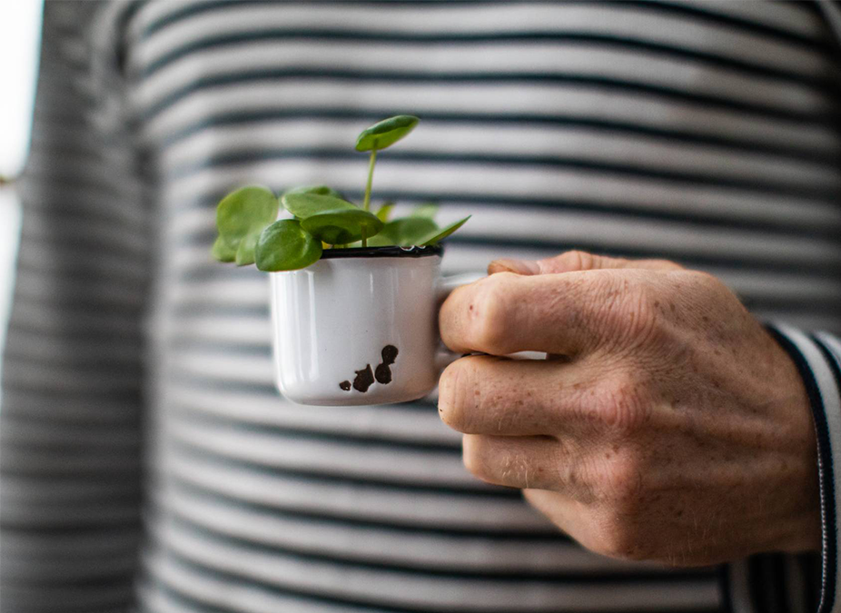
www.linkedin.com/in/matthewejruddle/
matthew.ruddle@abingdon-witney.ac.uk

