Slide 1
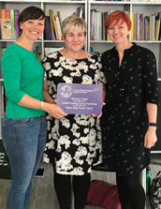
Helicopter Stories at
Bognor Regis Nursery School
Alison Stead & Cathryn Twine
Notes:
Introductions

Slide 2

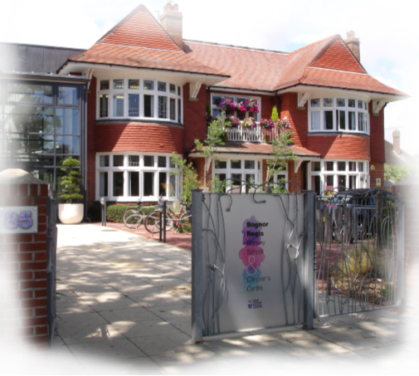
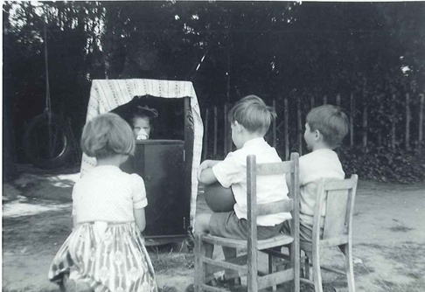
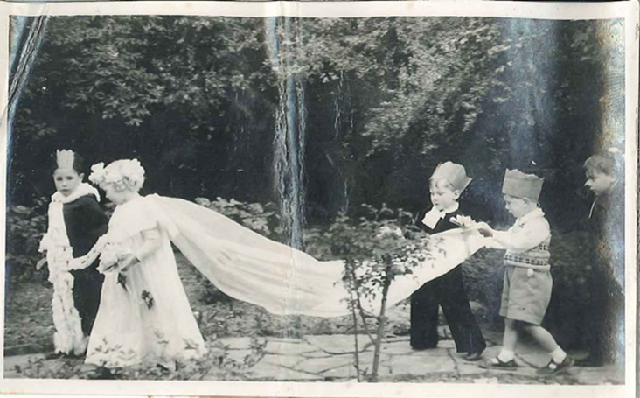
Our Story
Notes:
The Nursery School has served the local community since the 40s
Practice is based on the relationships built with children and families, starting with the child

Slide 3

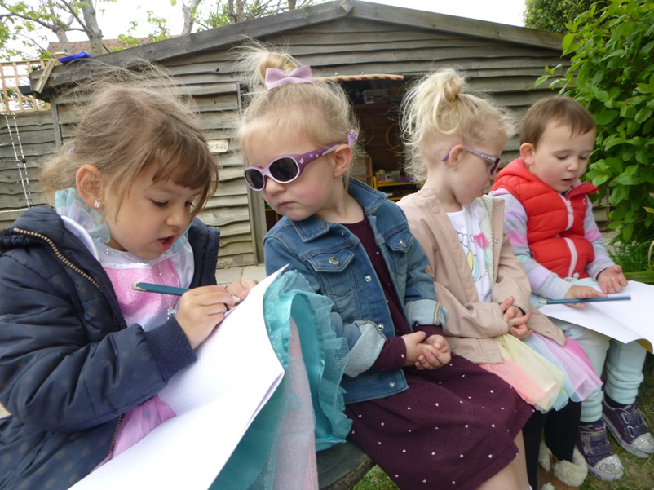
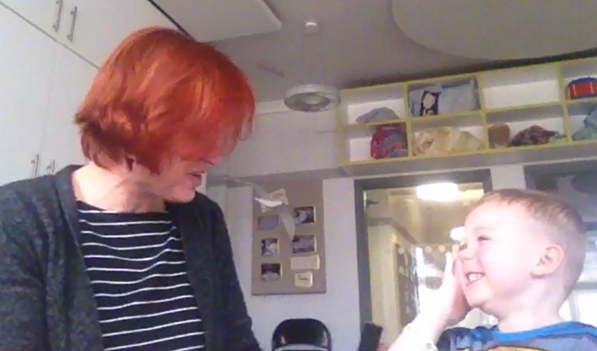
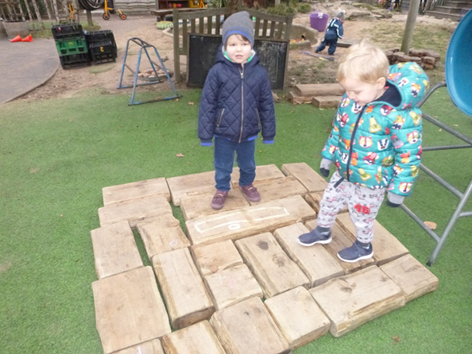
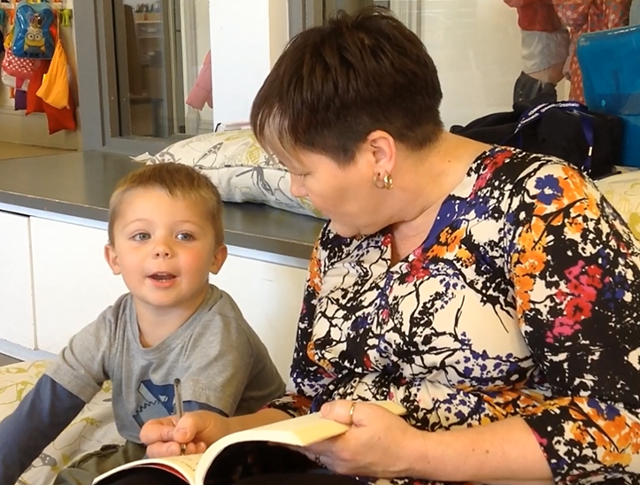
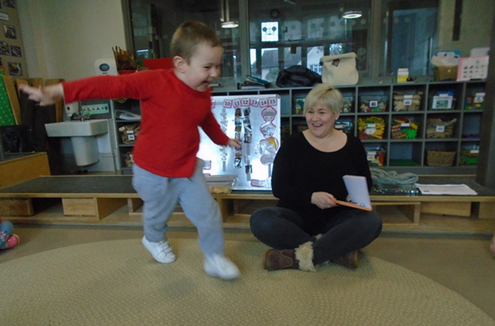
Notes:
Context

Slide 4
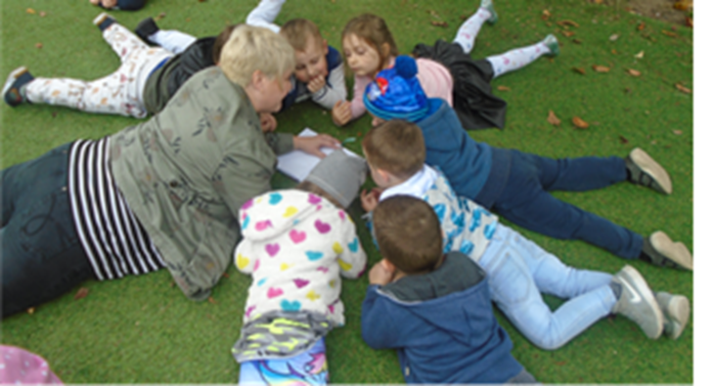
Establishing Helicopter Stories
Notes:
In September Helicopter Stories had to be introduced from the beginning again as all of the children in my key group except one were new. Initially I increased the frequency of the sessions to introduce the routine and enable the group to become familiar with both the story telling and story acting. It also supported the children in coming together and becoming established as a group.
Once the children gained confidence with Helicopter Stories we continued with a dedicated Helicopter Story day where private stories could be taken during the session time and then they would be acted out at grouptime with our paired key group.
Helicopter Stories has become a big part of our key group, often children are requesting to tell a story throughout the week in addition to our Helicopter Story day. So of course I scribe the story they dictate and then we make time in grouptime to act them out. This may be just one child asking to tell their story or there may be a few who all want to tell a story. Their stories have progressed at different rates and in different ways and so have their acting skills.
It has been incredibly powerful to see children asking to tell their stories and taking ownership knowing their voice will be heard. 11 out of 16 children have initiated stories.

Slide 5
Curriculum links………….
PSE
Talking about feelings and emotions
Confidence to act
Taking turns
Working within agreed expectations
Communication & language
Characters
Grammar
Sentence structure
Listening and attention
Sharing ideas
Following directions
Vocabulary
Use of rhythm and intonation
Physical Development
How they act out the role including use of space, actions, control
of body
Literacy
Break the flow of speech into words
Use of words/phrases from favourite stories
Listens to stories
Story structure
Settings events characters
Knows information relayed in print
Conventions of writing
Maths
Use of mathematical language
Sequencing events
Expressive Arts and Design
Taking on a role
Uses movement to express feelings
Introduces a storyline
Acts co-operatively with others
UW
Places
Special occasions
Roles e.g. police
Family and special people
Knowledge of the natural world

Slide 6

Repetition
Notes:
Repetition plays an important part in young children’s learning. It supports their developing competency and confidence in acquiring a range of skills including language. Children extend their learning and development by adding to their existing knowledge.

Slide 7
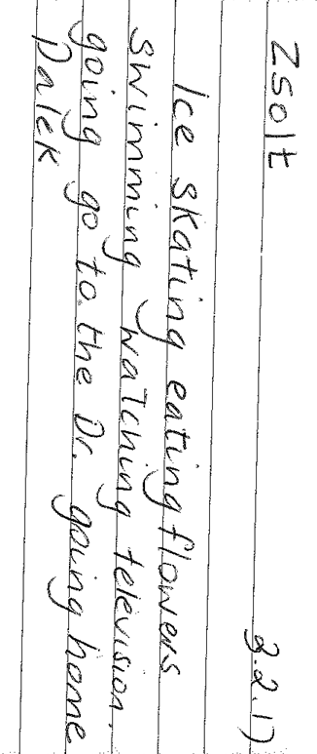
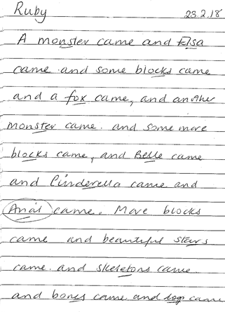
A story list
“a mere listing of items on the table, has an unspoken plot. ‘A crayon comes, a paper, a scissors’ may be taken as: Pretend I am a crayon and I color on a paper and the scissors tries to cut me and I roll off the table.’ There is always a plot. The words imagined in action and they become the script for the play.”
PALEY, V.G. (1991) The Boy Who Would Be a Helicopter p.7-8
Notes:
Often children start with a list on their storytelling journey. It may be just a list of characters or sometimes it is a list of objects that the child can see. Children appear to become empowered by the adult committing their spoken word to paper which then gives impetus to them continuing the story in this list form.

Slide 8
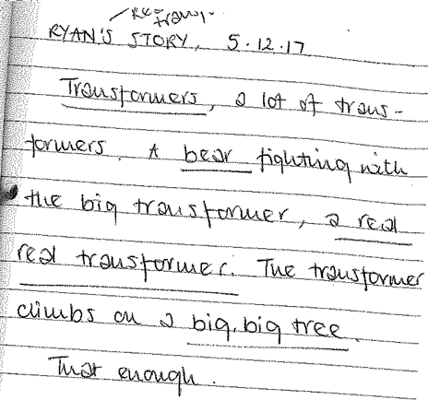
Over time…
Notes:
Children’s stories have developed over time, for example Ryan’s first story was based on a familiar song. Over five months his stories have progressed to include other influences from his own experience such as Transformers and Power Rangers. Ryan’s story telling have become more complex including a greater variety of characters engaged in action.
This is a trend we have noticed for many of the children as they engaged with Helicopter Stories and become more confident as authors.

Slide 9
Confident authors
Notes:
This is a trend we have noticed for many of the children as they engaged with Helicopter Stories and become more confident as authors. This child who was identified as Gifted and Talented for Understanding the World explored his love of nature in his stories. He also started to tell stories at home and his mum brought them in to share with his key worker.

Slide 10
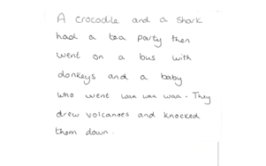
Stories from home
Notes:
Evelyn regularly asks to tell a story and one day she arrived at Nursery School saying “look what mummy did” She proudly showed me the the story her mum had written down for her. Of course we acted it out at grouptime.

Slide 11
Feedback from parents
"E shared his journal and had lots to say about the pictures. He also read his fantastic stories to us. We love this idea and it is great to see he is engaged writing stories."

Slide 12
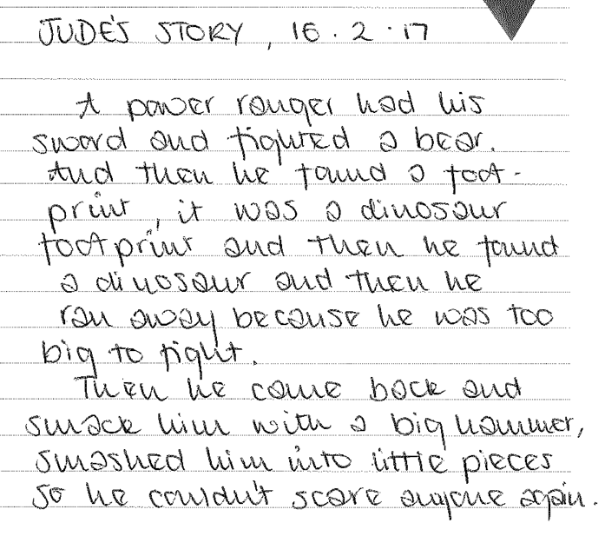
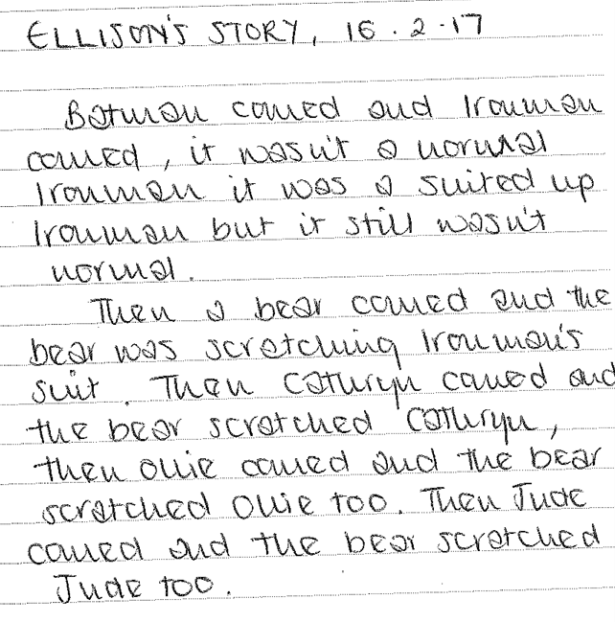
Themes and influences
“Seeing other people’s ideas for stories………helps children see new and creative possibilities. They use what they find, rearrange, alter, adapt ideas that other people have, for their own stories” BRUCE T (2007) Cultivating Creativity in Babies, Toddlers and Young Children p.68
Notes:
Ellison, and Jude would often sit together as their stories were scribed and they would tell similar stories, borrowing ideas from one another. They often played together engaged in the themes told in their Helicopter Stories which usually involved superheroes.

Slide 13
Managing feelings and emotions
“Picking through the pieces of what the world throws at them the children seek out their own meanings and understanding through the tools at their disposal-play and acting out-crafting their scenarios with great care.” Lee, T (2003) The theatre of three to fives, a society in miniature, The Journal of National Drama.
Notes:
Oliver explored a wide variety of themes and often emotions featured strongly in his stories. His stories included characters who got annoyed, forgot things, went to hospital, ran away and got hurt. Children often use their play and in turn their stories to make sense of their world.

Slide 14
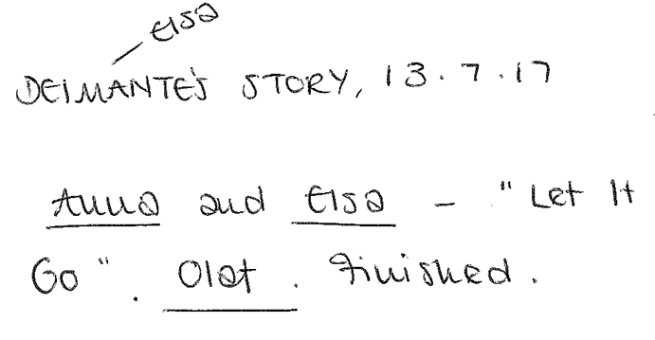
Children with English as an Additional Language
Notes:
Children with English as an Additional Language are motivated to participate in Storytelling and story acting. They gain the confidence to try out their spoken English as their stories are scribed. Children hear their words repeated back as the adult writes their story and they have the opportunity to hear stories told by their peers, thus developing their vocabulary. Their understanding is supported through friends modelling actions as they act out stories together.

Slide 15
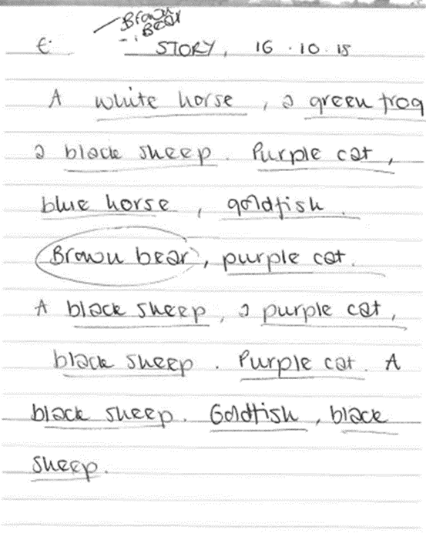
Wow moments
E has English as An Additional Language and has a place in our SSC. He had attended Nursery School for about 10 months and had never volunteered to tell a story before. However one day when asked he said “yep” He thought long and hard and initially I couldn’t understand the first words he said but then he began with the words “A white horse.” I clarified that this was the beginning of his story and he nodded and then began a list type story which was directly linked to his favourite story and one of our core books “Brown Bear, Brown Bear What Do You See?”
This really was a wow moment! E chose to be the title character in his story when we acted it out and the number of roles in his story meant that a lot of his peers were involved. It was lovely feeding back to his mum this significant step.

Slide 16
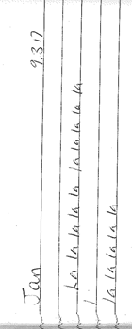
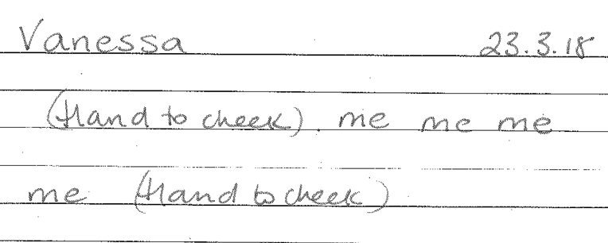
Children with Special Educational Needs
Jan was excited to see his name written. He then sang the age old chant of the playground.
Vanessa was also excited to see her name and after gesturing then pointed and said “me.” The adult read back what had been written and Vanessa’s continued to respond as the adult scribed.
Notes:
As a school with a Special Support Centre, that is integral to our practice, we have always reflected on how best to support children with additional needs to participate in our Helicopter Stories. Often children have been involved in the acting out of stories rather than the telling, although this is dependent upon the child. As a child centred approach, Helicopter Stories supports children to participate in their own way and the children accept everyone’s unique way of acting out or taking on a role. However, more recently we have been considering how to engage children with SEN in telling their stories influenced by Dycorts School, a Helicopter Centre of Excellence. We have begun to engage the children with some success although it is early days and we are excited to see how this will develop for us.

Slide 17
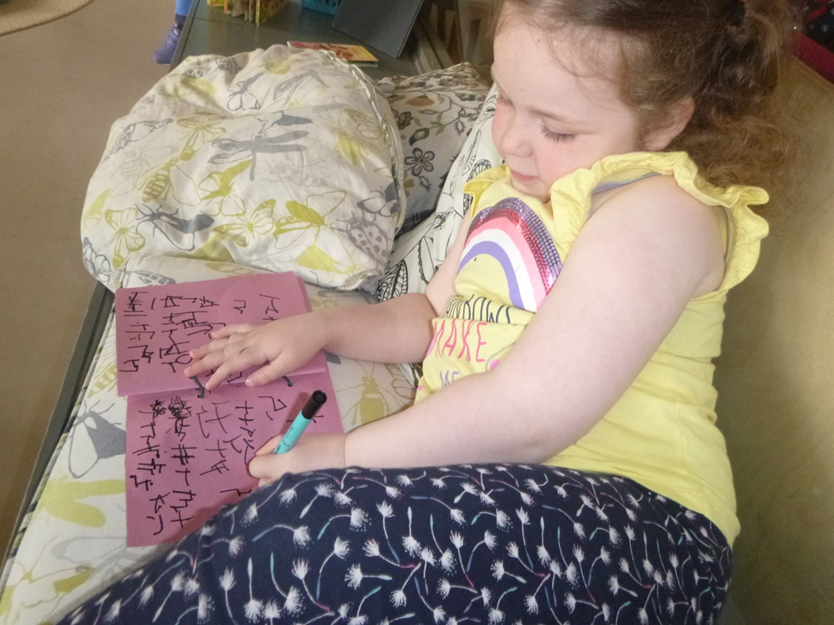
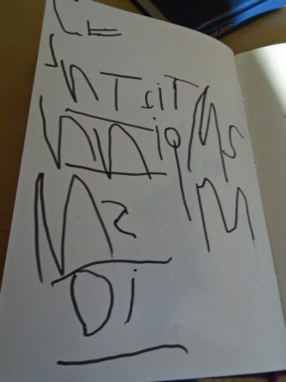
Meaningful Writing
“In Helicopter Stories, the thing that is most precious to the child, their story is written as they watch. They witness first-hand how writing captures their words and perceive how ingenious mark making is. Often they become self-motivated and find their own way to explore the connection between the spoken and written word that is such a vital part of early literacy.” Lee, T, Drama, Teach Primary Issue 9.6
Notes:
Children see adults scribing their stories adding valuing to their spoken word, and they begin to develop their understanding that writing has a purpose. They see that each written word stands for a spoken word, supporting the concept of one to one correspondence and the symbolic nature of writing. Writing becomes increasingly meaningful to the child as they engage in Helicopter Stories and often they want to take on the role of the scribe, seeing themselves as a writer.
Example:While Cathryn took private stories, children sat alongside with their own books and also took private stories!
Emily was scribing Brodie’s story using recognisable letters and asking “who do you want to be?” and “what’s next?”
Then Brodie took a turn to scribe for Emily who said: “write my name, look how my name like this” showing him what her name looked like. After having a go at her initial letter he asked “is this your name?” having written a letter that had a similar shape to the letter E

Slide 18
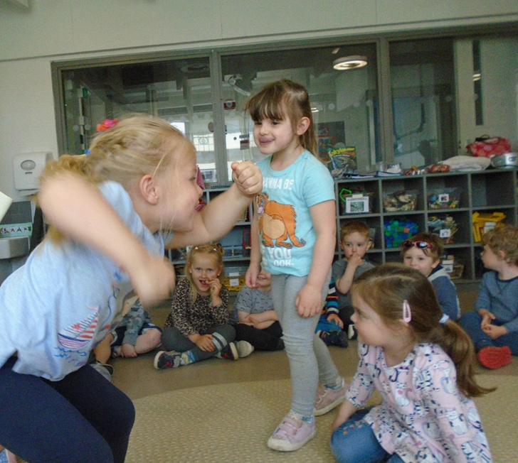
Children gain many skills performing in front of others. These key skills can impact on the children; developing their confidence, adaptability and self-awareness

Slide 19
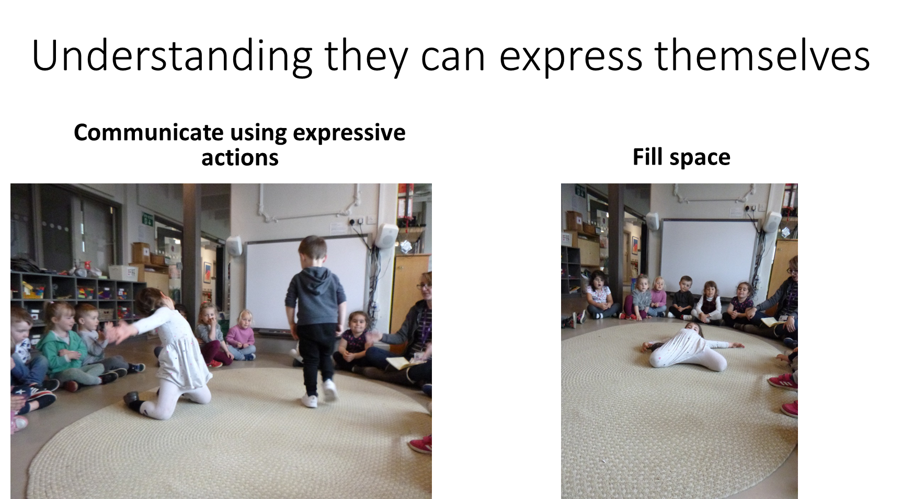

Slide 20
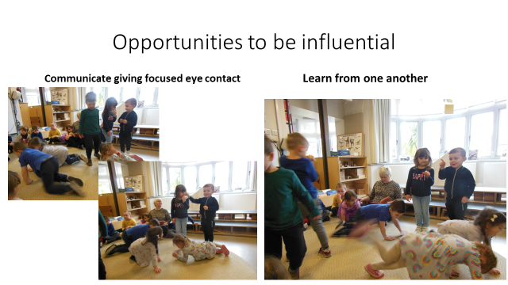

Slide 21
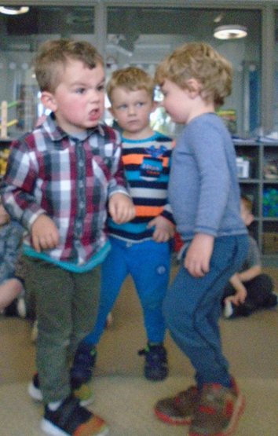
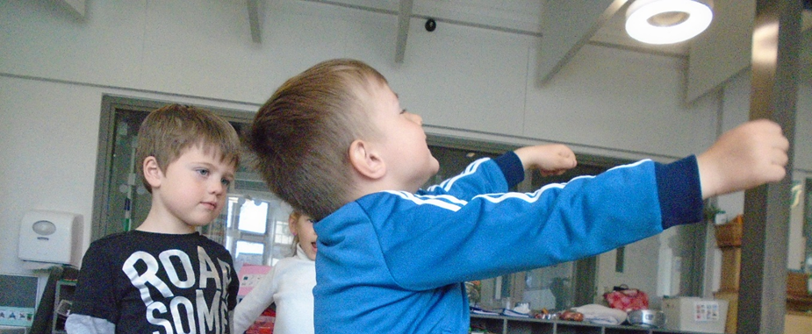
Show curiosity and interest in other’s actions.
Be an audience and show appreciation

Slide 22
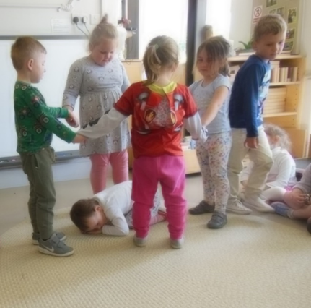
Working together for a common goal
Have the confidence to be adaptable and problem solve

Slide 23
Stories are developing with more variation now. As soon as our books are out children come to tell stories and understand what it’s all about
Children with EAL want to contribute using their emergent language and are joining in the acting
I have noticed that several of my children have begun to put on shows as part of their play using a carpet as a stage
Children more now engaged with it. They are picking up each others ideas. One child was away for 7 weeks, came back, saw my book and said “Thomas story”
Elijah who took a very long time to settle is now telling stories every week. Children are getting braver to get up and act
I was very apprehensive to start with as the initial training took place before I joined the school. I didn’t know how it would suit my group. I learnt from my colleagues modelling the approach and through reading Helicopters, Dragons and Princesses. Children are already wanting to tell stories, the growth in their self confidence and self esteem is incredible.

Slide 24

I was so scared of it to begin with, worried I was going to do it wrong but now I’m thinking next year I want to do that better, develop that part more, encourage this next step. It’s a journey I’m on with the children.
I feel more confident now in scribing children’s stories and in supporting acting then out at group time. I have loved seeing progression in the children’s imagination and how they are joining words together to articulate the story they have thought of. When a new child tells a ‘story’ for the first time it is AMAZING!
It has been interesting to see how story themes change over time depending on the cohort of children. Last year Zombie stories were very prominent with one child’s enthusiasm sowing the seed of this storyline with others. This year has been much more varied though Paw Patrol and dinosaurs have provided starting points for many children. It has been lovely to see one child respond to hearing the story of the 3 little pigs at home and bringing that into both his stories and Loose Parts play in the garden.

